Slide 1
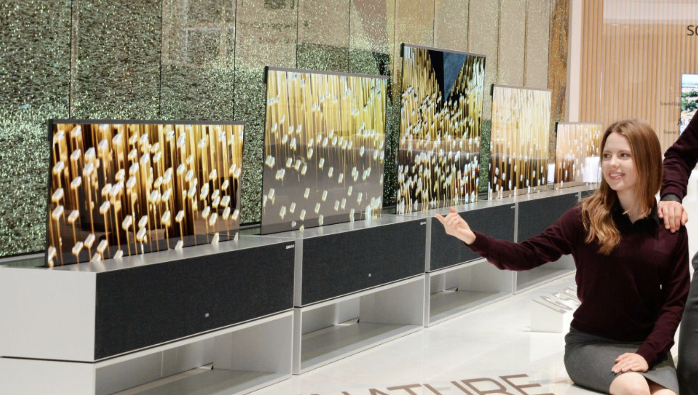
ROLL UP TV
By – Digisha Singhal

Slide 2
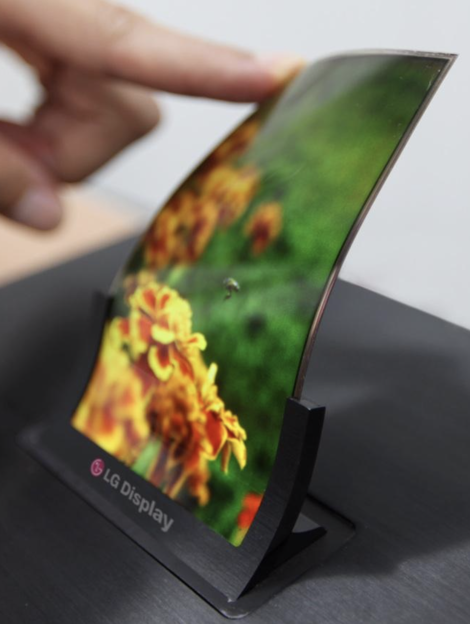
Product Description
Key word – Roll up tv
It is basically a TV with its adjustable screen, wherein the screen could be rolled when not in use saving a lot of space.
This is a TV that’s there when you want it and disappears when you don’t.
The screen can rise up or drop down electronically.

Slide 3
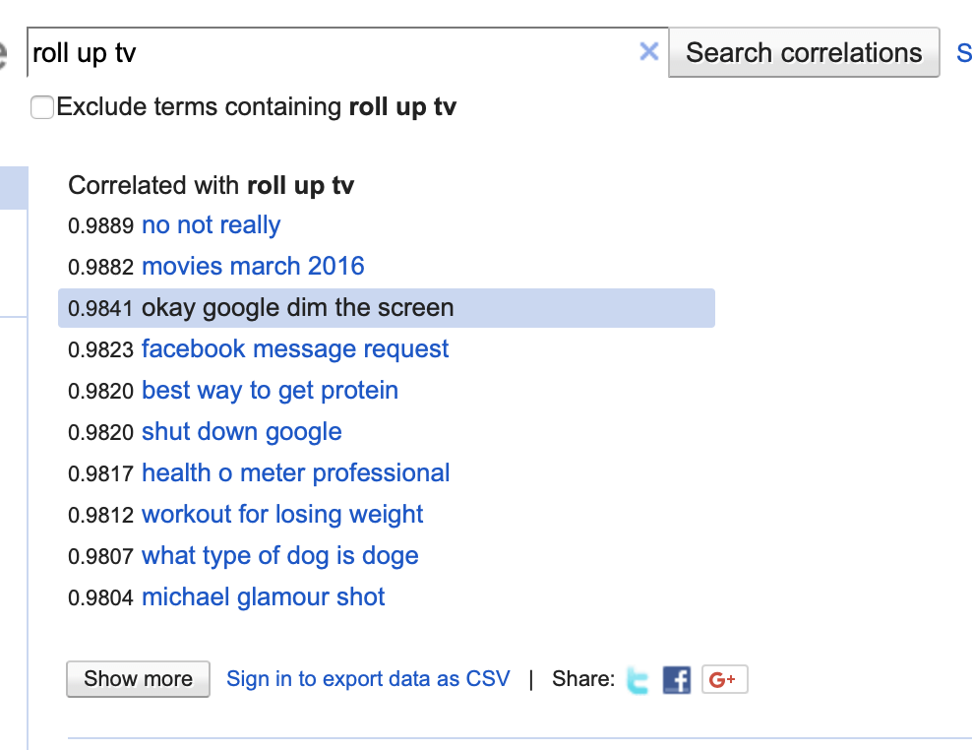
Screenshot of term search

Slide 4
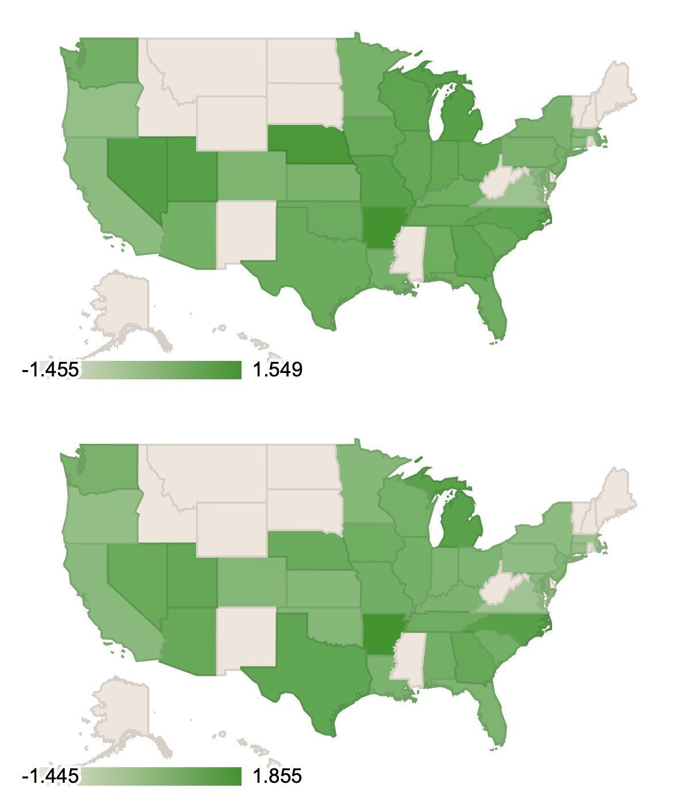
Screenshot of geographical area
(r=0.9841)
The states where the product will sell more or will be more popular are colored with a darker shade of green.
Michigan, Arkansas, North Carolina are amongst these states.
And with darker green shade on the east coast compared to the west coast, it attracts more customers on the east coast of United States
Roll up TV
okay google dim the screen

Slide 5
Marketing Campaign conclusion
Roll up Tv can save up your space when not required.
It’s a smart TV, that is integrated with google, and can actually dim the screen when asked though google assistant.
One could search on the TV ‘The best way to get protein’ or ‘Michael glamour shot’.
It has applications like Facebook, to message of look at profiles of other people on TV screens.
People could work out with online teacher, showing methods to loose weight.
The product is more popular with people who are more dependent on internet, or need a smart TV that is integrated with various different assistants mostly located in the East coast of United States.

Slide 6
References
Google.com. (2019). roll up tv - Google Correlate. [online] Available at: https://www.google.com/trends/correlate/search?e=roll+up+tv&e=okay+google+dim+the+screen&t=all# [Accessed 17 Feb. 2019].
Forbes.com. (2019). LG Roll-up TV Joins Samsung And Sony In Entertainment In Excess At CES 2019. [online] Available at: https://www.forbes.com/sites/curtissilver/2019/01/07/lg-roll-up-samsung-sony-8k-ces-2019/#16921d7d7a25 [Accessed 17 Feb. 2019].
ShivarWeb. (2019). Google Correlate: How To Use It For Marketing, SEO & Content. [online] Available at: https://www.shivarweb.com/5374/google-correlate-for-marketing/ [Accessed 17 Feb. 2019].

